Slide 1
Neural Semi-Supervised Learning
Alexander Fabbri
09/11/2018

Slide 2
Outline
Overview of Semi-Supervised Learning (SSL) and traditional methods
Neural SSL and background on generative models
Presentation of four papers
Discussion
Goal: Give an introduction to methods and applications

Slide 3
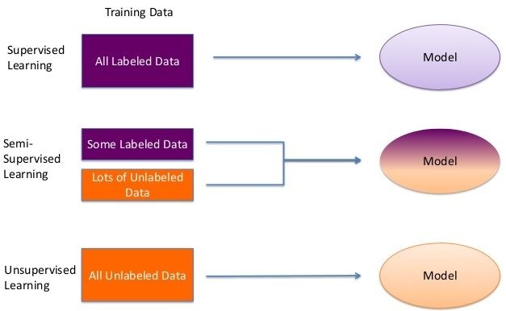
What is SSL?
Algorithms that are trained on a combination of labeled and unlabeled data
Image: https://viblo.asia/p/an-introduction-to-generative-adversarial-networks-gans-a-semi-supervised-learning-3P0lPmqg5ox

Slide 4
Why SSL?
Labeled data can be expensive to collect as often requires domain experts
Penn Treebank
There is often access to an abundance of unlabeled data
News, forums, images

Slide 5
Traditional SSL Methods
Generative models
Graph-based SSL
Self-training

Slide 6
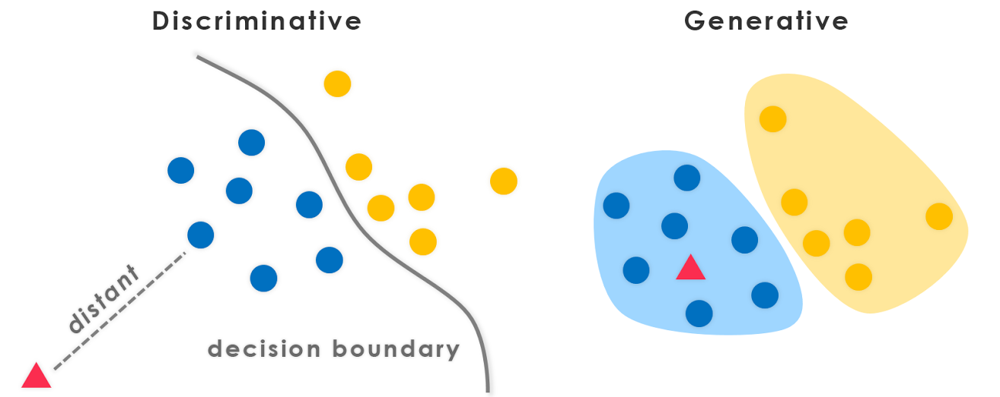
Generative Models
Data we observe comes from some underlying distribution, which we want to sample to generate new data points
We want to infer a function to describe hidden structure from unlabeled data that can be effectively exploited for the ultimate task (density estimation)
Image: https://datawarrior.wordpress.com/2016/05/08/generative-discriminative-pairs/

Slide 7
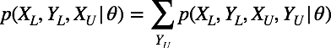
Generative Models cont.
Used in generating pictures, music, text, images
Want to model:
Semi-supervised setting we have:
Typical example: mixture of Gaussian mixture models solved using Expectation Maximization algorithm

Slide 8
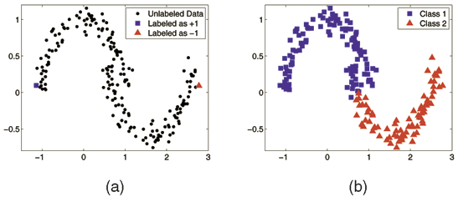
Graph-based SSL
Use the underlying structure of the graph to propagate labels
Image: https://www.semanticscholar.org/paper/Linear-Neighborhood-Propagation-and-Its-Wang-Wang/38a9b0963a279e7aab52cd50b095ecc9f8e6da49

Slide 9
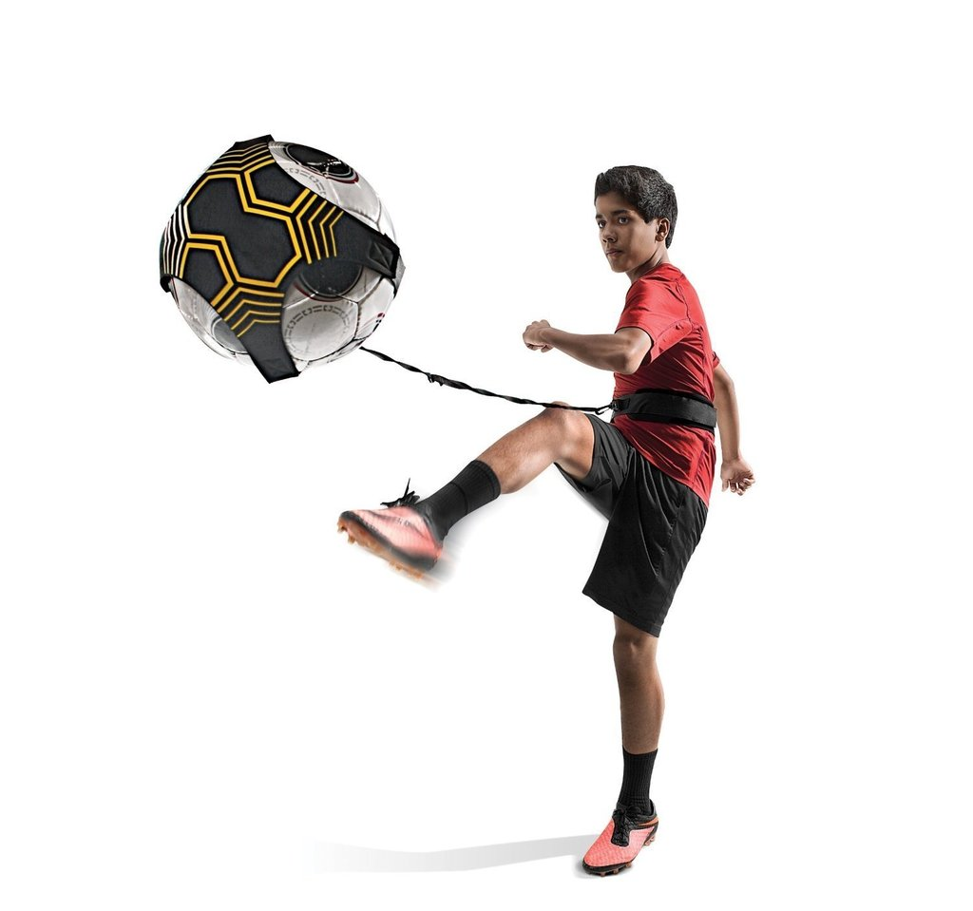
Self-training
Algorithm
Train a function from labeled data
Predict labels for unlabeled data
Add predicted labels to labeled data
Repeat
Variations based on which and how many predicted labels are added to the labeled data. Related to co-training

Slide 10
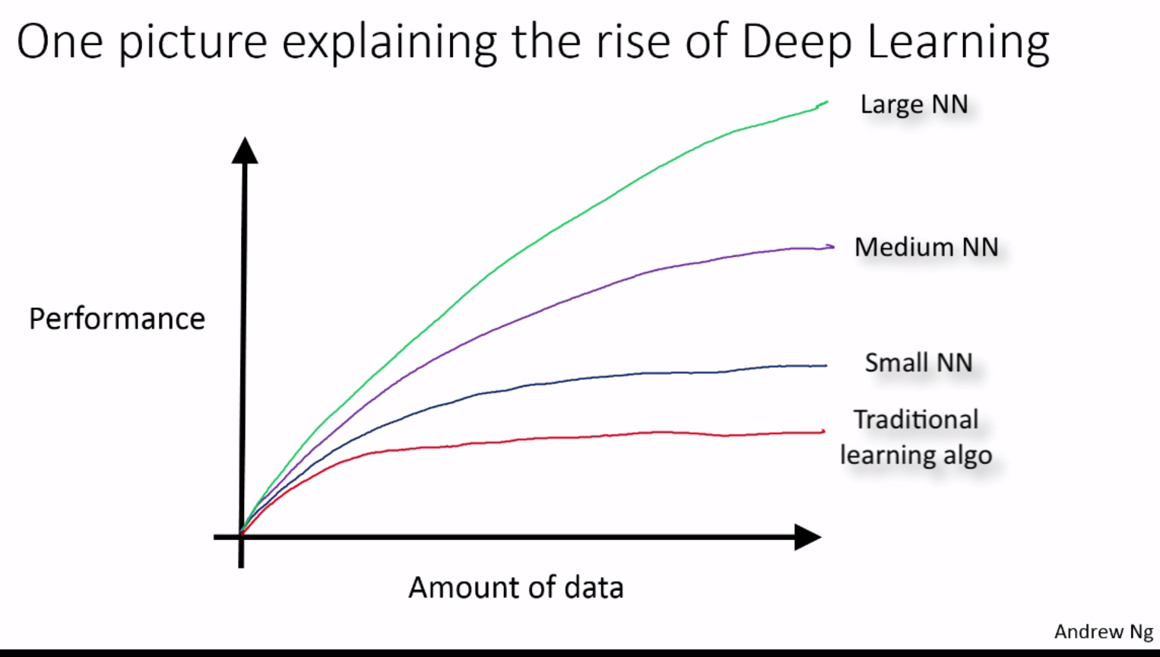
Neural Networks
Neural networks have shown amazing results when trained on large datasets in tasks such as image recognition and machine translation
Image: https://www.nextbigfuture.com/2016/03/how-scale-is-enabling-deep-learning.html

Slide 11
Neural SSL
“If you only have 10 examples of something, it’s going to be hard to make deep learning work. If you have 100,000 things …, that’s the kind of scale where you should really start thinking about these kinds of techniques” — Jeff Dean
Can we achieve similar results when we do not have access to such large datasets? Can we use labeled examples from another dataset, task or language?
Ideas with some success: Generative models, pre-training, transfer learning

Slide 12
Neural SSL for NLP
Often used for sentiment analysis and text classification
Recent work in pre-training neural networks for better representations
Going beyond word2vec to deeper shared representations (even whole networks, like in Computer Vision!)
ELMo, ULMfit, OpenAI pretraining, Contextualized String Embeddings — all from 2018

Slide 13
Papers covered
Semi-Supervised Learning with Deep Generative Models - NIPS 2014
Semi-Supervised Classification with Graph Convolutional Networks - ICML 2017
Strong Baselines for Neural Semi-supervised Learning under Domain Shift - ACL 2018
Deep contextualized word representations - NAACL 2018

Slide 14
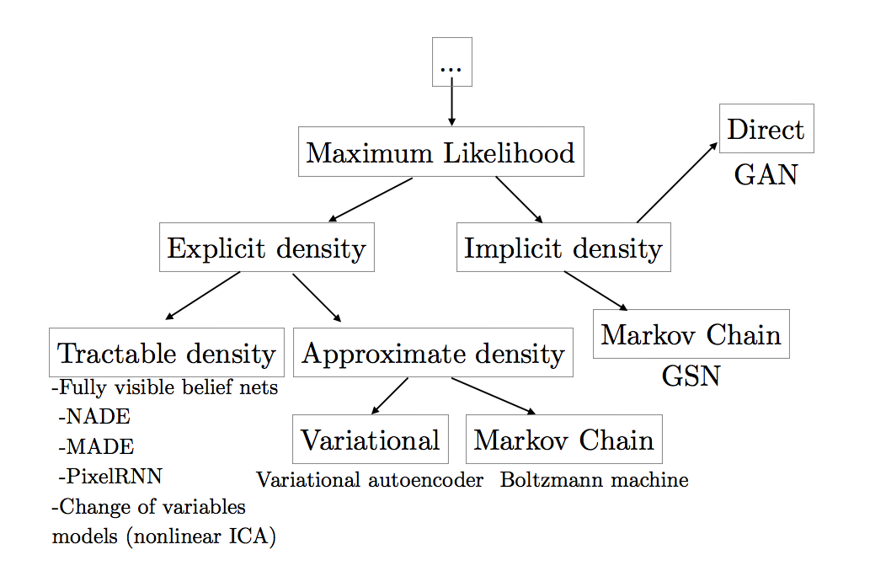
Background on Deep Generative Models
Image: https://arxiv.org/pdf/1701.00160.pdf

Slide 15
Why use Deep Generative Models?
Example: Building an image classifier where p(class | image) requires estimating a very high-dimensional function
Model the data as being generated from some low-dimensional or sparse latent variable z
p(image)=∫p(image|z)p(z)dz.
Then for classification, just need to learn p(class|z), which is usually a much simpler function
Can take advantage of unlabeled data

Slide 16
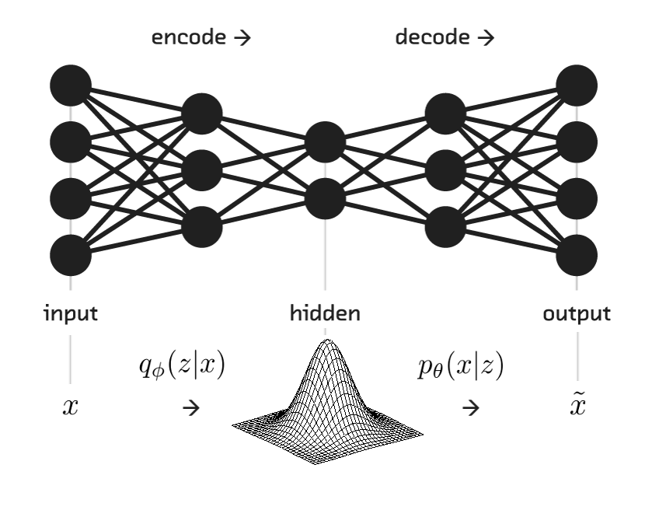
Variational Autoencoders
Image: https://blog.fastforwardlabs.com/2016/08/22/under-the-hood-of-the-variational-autoencoder-in.html

Slide 17
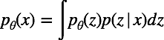
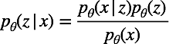
Variational Autoencoders cont.
Want to maximize the data likelihood:
Want to calculate the posterior density:
But, both are intractable!
So, define an encoder
that approximates

Slide 18
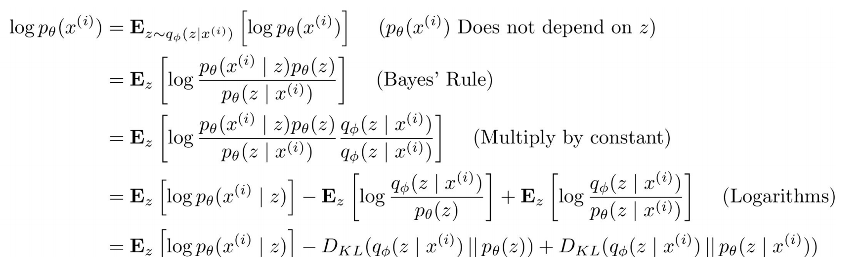
Deriving the Variational Lower Bound (ELBO)
Slide: http://cs231n.stanford.edu/slides/2017/cs231n_2017_lecture13.pdf

Slide 19
GANs
Minimax game where a discriminator network tries to distinguish between real images and those produced by a generator network
Central Equation:

Slide 20
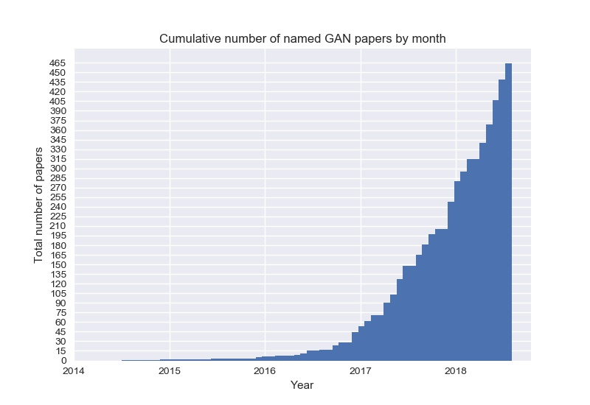
GANs cont.
Many variations — GAN-zoo
Image: https://raw.githubusercontent.com/hindupuravinash/the-gan-zoo/master/cumulative_gans.jpg

Slide 21
Paper 1: Semi-Supervised Learning with Deep Generative Models
Diederik P. Kingma, Danilo J. Rezende, Shakir Mohamed, Max Welling, NIPS 2014
Goals of the paper:
Develop a generalized and scalable approach for semi-supervised learning using deep generative models
Test three models on MNIST image classification

Slide 22
Proposed Models
Latent-feature discriminative model (M1):
Use variational inference to approximate samples from the posterior distribution over latent variables which are used as features to a classifier
Generative-semi-supervised model (M2):

Slide 23
Proposed Models cont.
Stacked generative semi-supervised model (M1+M2):
Rather than using the raw data x, use the latent representation from M1

Slide 24
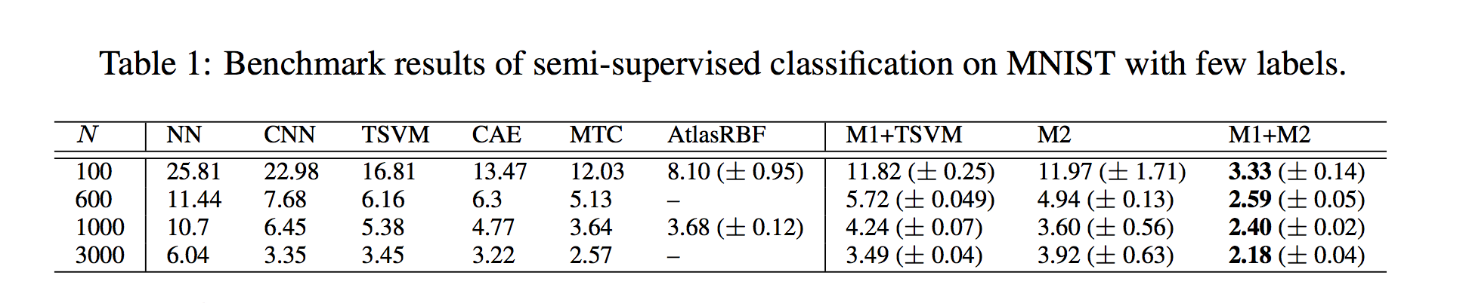
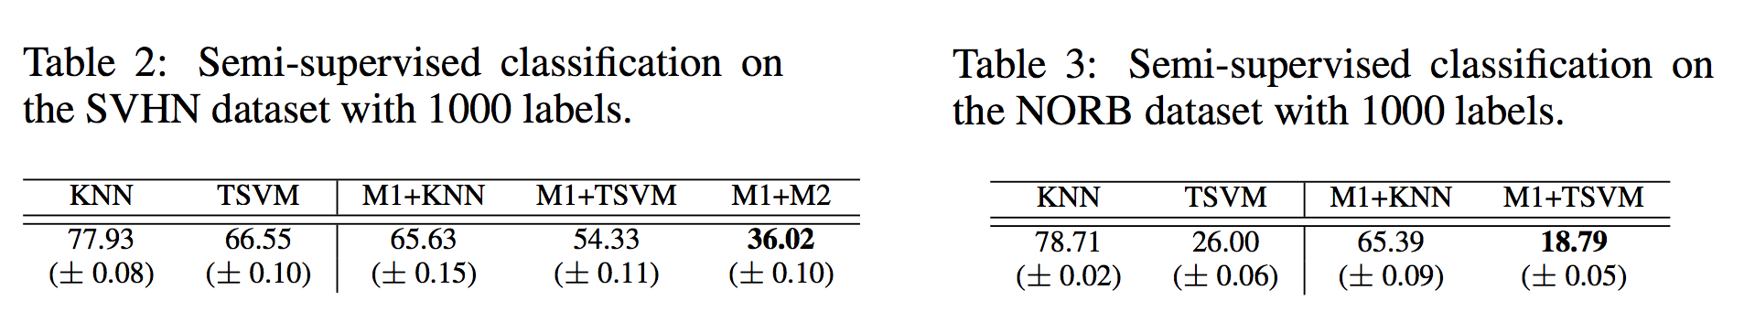
Datasets and Results

Slide 25
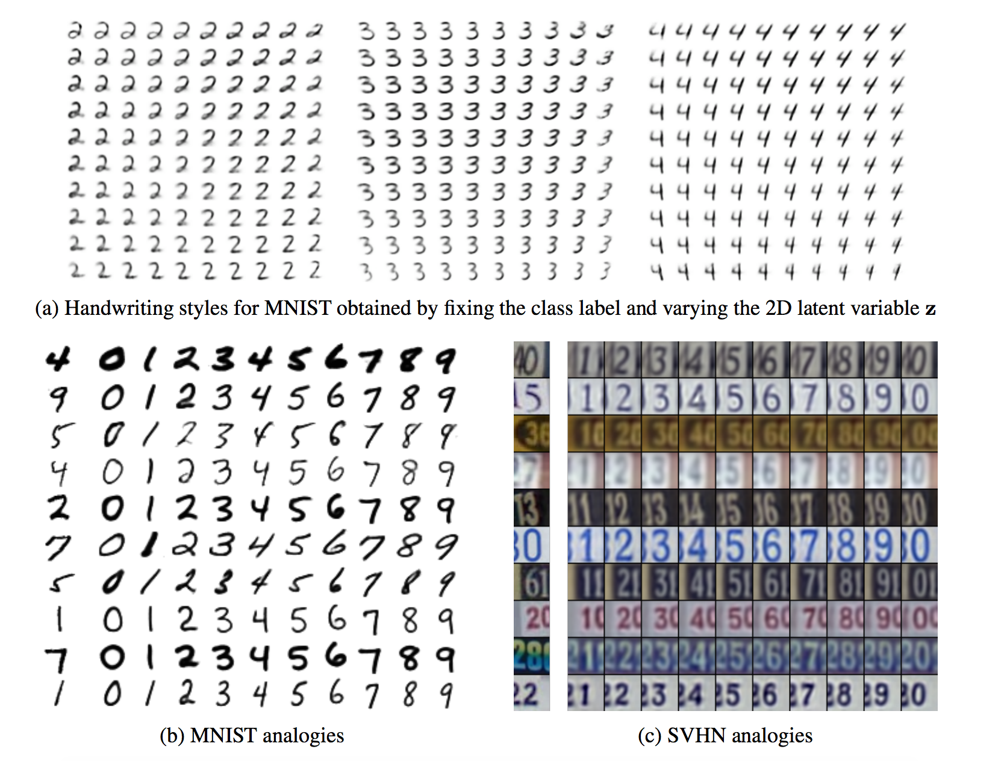
Experiment on handwriting styles learned

Slide 26
Discussion
The inference methods introduced in this paper can be extended to other networks to parametrize the likelihood function
A limitation of the model is that it scales linearly in the number of classes in the data

Slide 27
Paper 2: Semi-Supervised Classification with Graph Convolutional Networks (GCNs)
Thomas Kipf and Max Welling, ICLR 2017
Goal: Introduce a scalable semi-supervised learning approach on graph data motivated by spectral graph convolutions
Experiments based on citation networks and a knowledge graph datasets

Slide 28
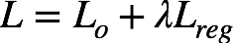
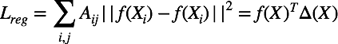
Graph-based regularization
Assumption: Connected nodes in the graph likely share the same label
Applicable to tasks such as sentiment analysis, but not cases where graph edges do not necessarily define similarity

Slide 29
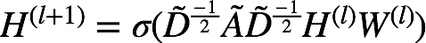
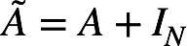
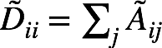
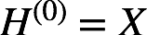
GCN layer-wise propagation
where
is the adjacency matrix
with self-connections,
is the degree matrix and

Slide 30
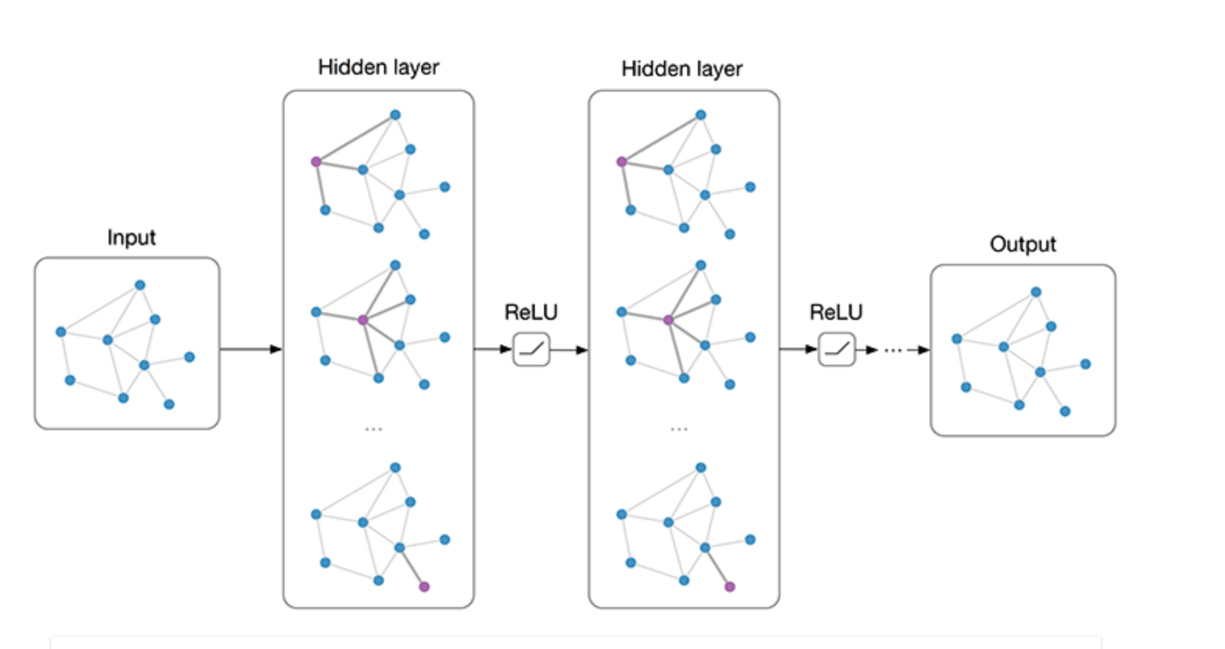
Architecture
Image: https://tkipf.github.io/graph-convolutional-networks/

Slide 31
Motivation behind equations
Spectral convolutions on graphs — a robust measure of spectral similarity
Defined as the multiplication of a signal x with a filter :
Where U is the matrix of eigenvalues of the normalized Laplacian
Under certain assumptions (see paper):

Slide 32
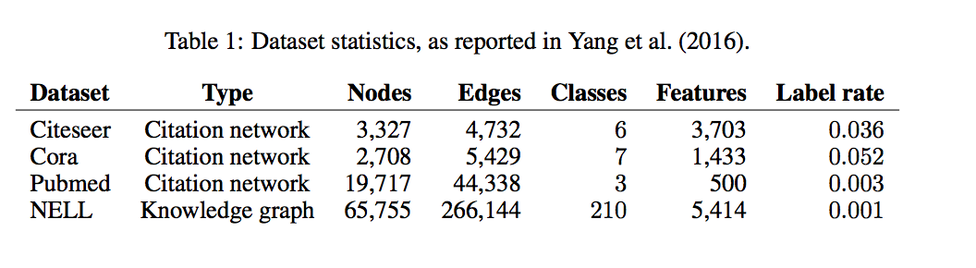
Datasets
Citation network datasets — Citeseer, Cora and Pubmed where nodes are documents and edges are citation links
NELL, a graph dataset extracted from a knowledge graph

Slide 33
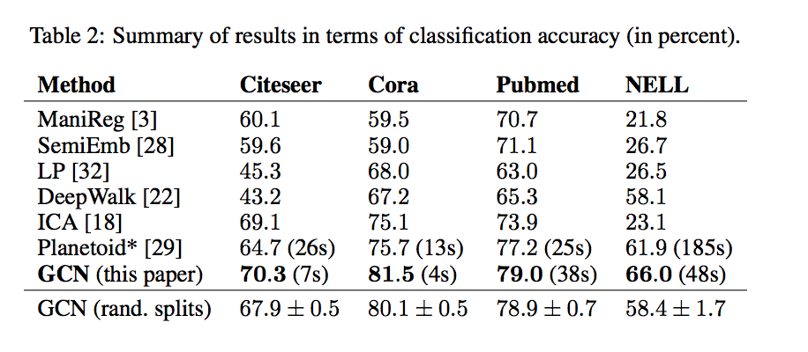
Results

Slide 34
Discussion
Efficient and effective method for semi-supervised classification
Cons:
Memory requirement
Lack of edge features

Slide 35
Paper 3: Strong Baselines for Neural Semi-supervised Learning under Domain Shift
Sebastian Ruder and Barbara Plank, ACL 2018
Goals:
Re-evaluate classic semi-supervised methods for neural networks under domain shift and introduce multi-task tri-training
Show that classic tri-training often outperforms SOTA

Slide 36
Classic Semi-supervised ‘bootstrapping’ methods
Self-training — discussed earlier
In the context of neural networks, often use relative order of confidence rather than ‘probability’ of predicted label, as it is more robust
Tri-Training — three models, add unlabeled data to labeled data if two models agree on its labels. Tri-training with disagreement

Slide 37
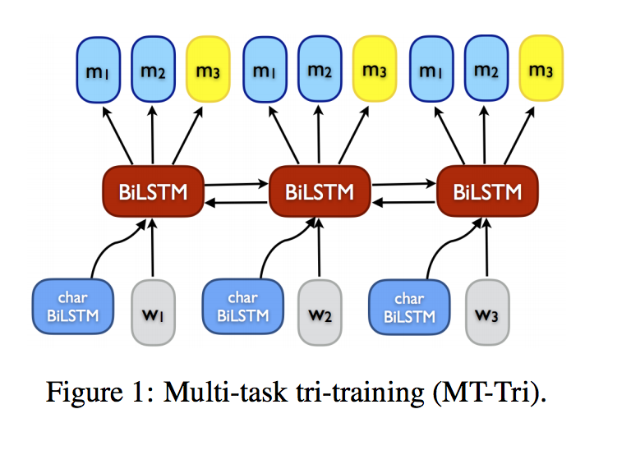
Multi-task Tri-training

Slide 38
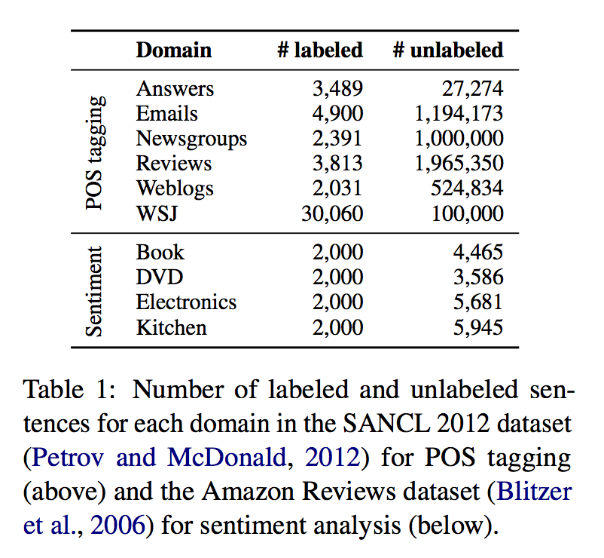
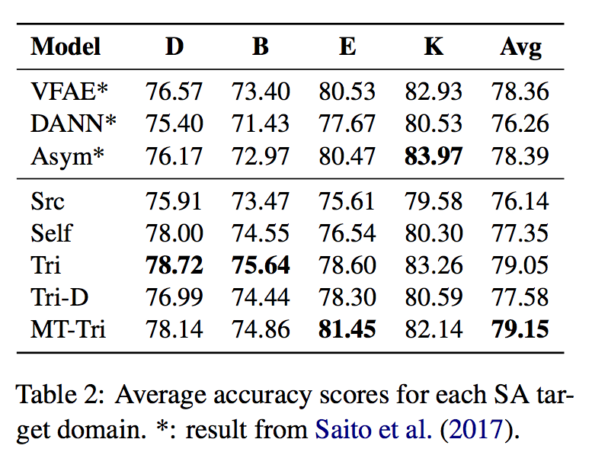
Datasets and Experiments

Slide 39
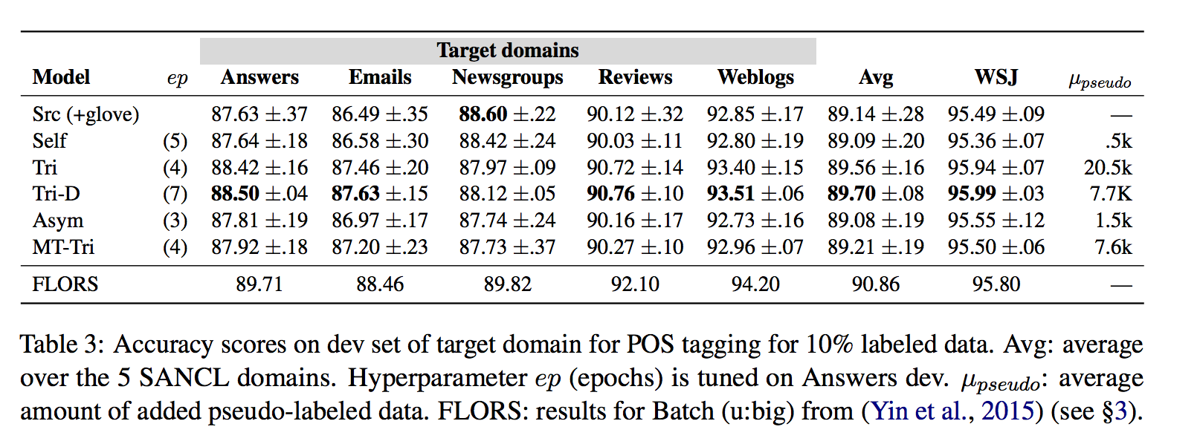
Additional Results

Slide 40
Discussion
Classic tri-training is able to achieve state of the art
Multi-task tri-training proposed for efficiency
Shows the importance of strong baselines for SSL, as emphasized in Realistic Evaluation of Semi-Supervised Learning Algorithms (2018)

Slide 41
Paper 4: Deep contextualized word representations
Matthew E. Peters, Mark Neumann, Mohit Iyyer, Matt Gardner, Christopher Clark, Kenton Lee, Luke Zettlemoyer, NAACL 2018
Goals:
Develop representations that model syntax, semantics as well as polysemy and show how these can be added to other models to achieve SOTA

Slide 42
Background
The idea of pre-training representations for NLP tasks is not new (word2vec, Glove), however, these representations fail to capture polysemy
Also, previous work has shown that different layers of deep recurrent networks encode different types of information (e.g. syntax)
Previous work on pre-training encoder-decoder pairs (Semi-supervised Sequence Learning, Unsupervised Pre-training for Sequence to Sequence Learning)

Slide 43
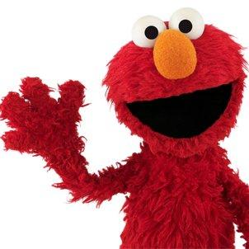
Introduction ELMo
Image: https://twitter.com/elmo

Slide 44
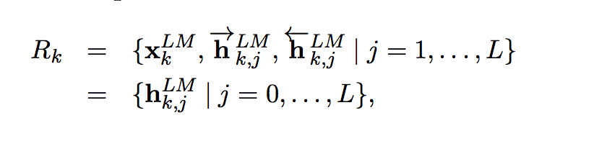
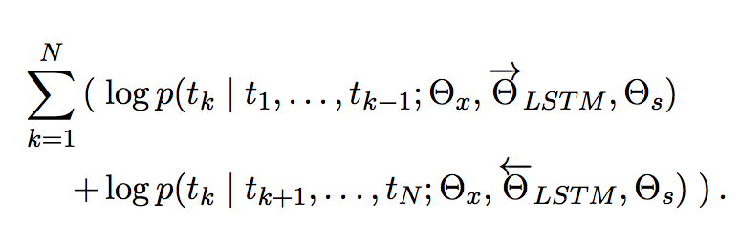
ELMo: Embeddings from Language Models
Compute word representations on top of bidirectional language models with character convolutions
L-layer bi-LM computes 2L+1 representations:
Bidirectional log-likelihood maximized:

Slide 45
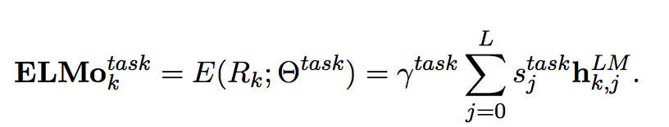
Central idea
Collapse all the layers into a single vector by calculating a task-specific weighting of all the layers:

Slide 46
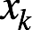
Incorporating ELMo into another model
Run the bi-LM and record all the layer representations for each word. Then the end supervised model learns a linear combination of these representations.
Freeze the weights of the bi-LM and concatenate with the ELMo vector and pass into the task RNN
In some cases, improvements were found by also adding ELMo at the output of the task RNN

Slide 47
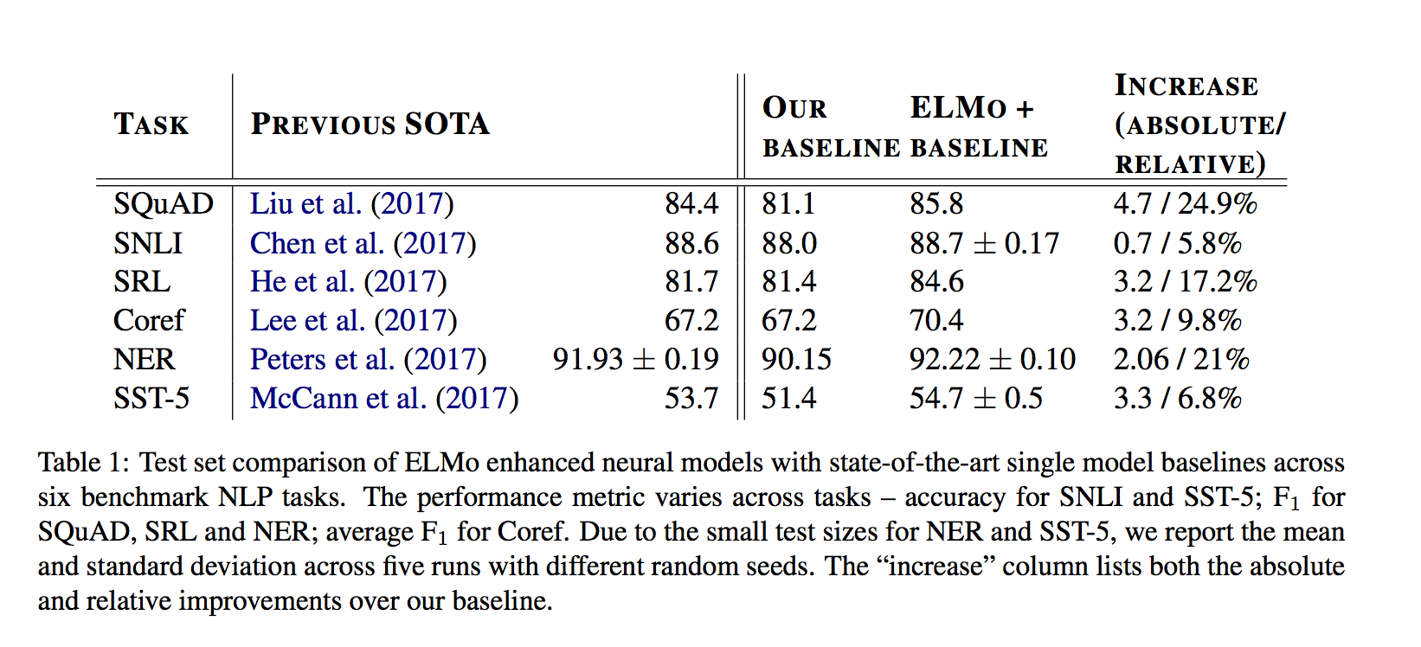
Datasets and Results:

Slide 48
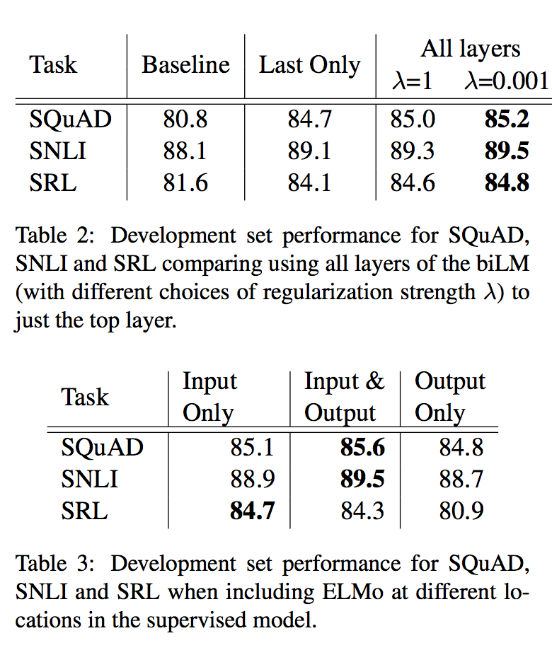
Results cont.

Slide 49
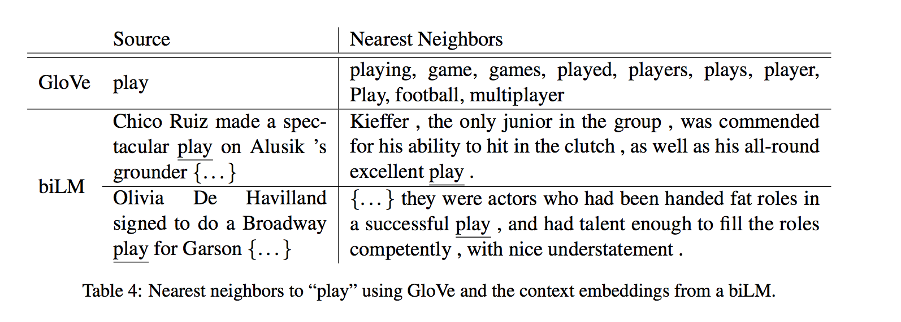
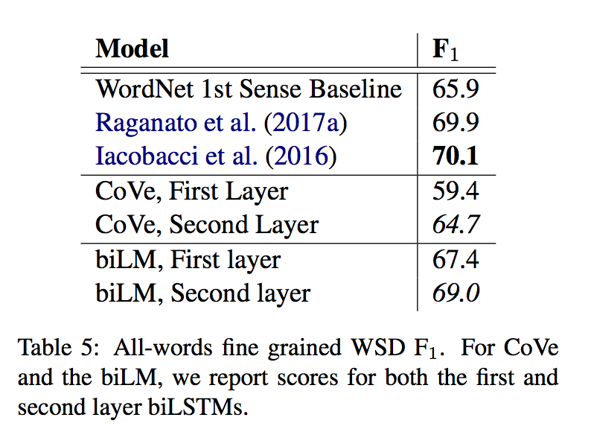
Performance on Word Sense Disambiguation

Slide 50
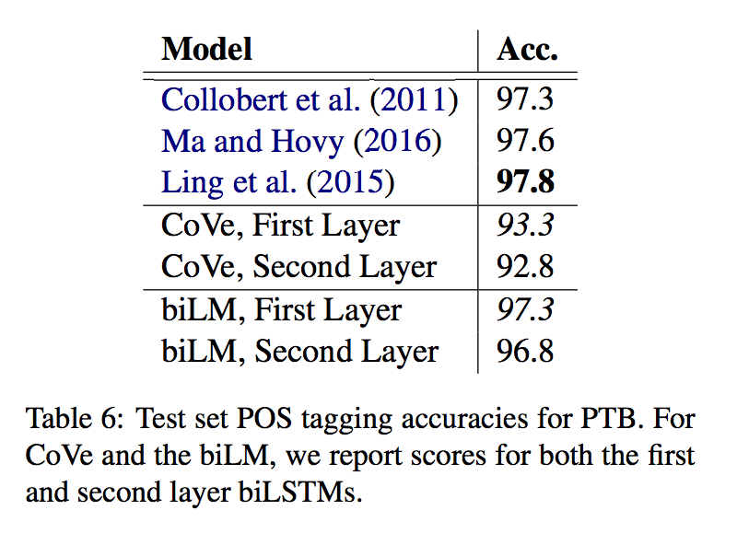
Performance on POS tagging

Slide 51
Discussion
word2vec and Glove are old news!
If you plan to incorporate pre-trained mono-lingual word representations into your model, ELMo is currently the best option
Notable mention for string embeddings:
Contextual String Embeddings for Sequence Labeling

Slide 52
Questions for class
What are some other problems for which semi-supervised learning is suitable?
Do humans learn by semi-supervised learning (a combination of ‘labeled’ situations and ‘unlabeled’ ones which help us infer a general structure about concepts)
Is there something more transferable about features from computer vision than language in the setting of pre-training neural networks?
What does language modeling actually teach a neural network? — language modeling Twitter thread

Slide 53
References
Semi-supervised Learning with Deep Generative Models - Diederik P. Kingma, Danilo J. Rezende, Shakir Mohamed, Max Welling
Semi-Supervised Classification with Graph Convolutional Networks -- Thomas N. Kipf and Max Welling
Deep contextualized word representations -- Matthew E. Peters, Mark Neumann, Mohit Iyyer, Matt Gardner, Christopher Clark, Kenton Lee, Luke Zettlemoyer
Strong Baselines for Neural Semi-supervised Learning under Domain Shift -- Sebastian Ruder and Barbara Plank
https://web.stanford.edu/class/cs224n/lectures/lecture17.pdf -- Kevin Clark
https://www.shakirm.com/slides/DeepGenModelsTutorial.pdf -- Shakir Mohamed and Danilo Rezende
https://blog.fastforwardlabs.com/2016/08/22/under-the-hood-of-the-variational-autoencoder-in.html -- Miriam Shiffman
http://cs231n.stanford.edu/slides/2017/cs231n_2017_lecture13.pdf -- Fei-Fei Li & Justin Johnson & Serena Yeung

Slide 54
Other Relevant Generative Papers
Auto-Encoding Variational Bayes
Generative Adversarial Nets
Semi-Supervised Learning With Ladder Networks
Auxiliary Deep Generative Models

Slide 55
Other Relevant Graph-based Papers
STRUCTVAE: Tree-structured Latent Variable Models for Semi-supervised Semantic Parsing
Graph Attention Networks
Variational Graph Auto-Encoders
GLoMo: Unsupervisedly Learned Relational Graphs as Transferable Representations

Slide 56
Other relevant pre-training NLP task papers
Contextual String Embeddings for Sequence Labeling
Universal Language Model Fine-tuning for Text Classification
Improving Language Understanding by Generative Pre-Training

Slide 57
Fin

